Slide 1
Lecture 5
Introduction to state space search
Generate and test

Slide 2
Introduction to state space search
Problem solving involves doing right thing at right time
Given a problem to solve, the task is to select the right moves that leads to solution
Next slide shows problem of moving football for goal
What is the intelligent thing to do?
To solve problem in computer, one must first create a representation of the domain;
in this case, a football game being the problem, the decision to make next, the set of alternatives available, and the moves one can make.
There are many players and the outcome depends on their moves too.

Slide 3
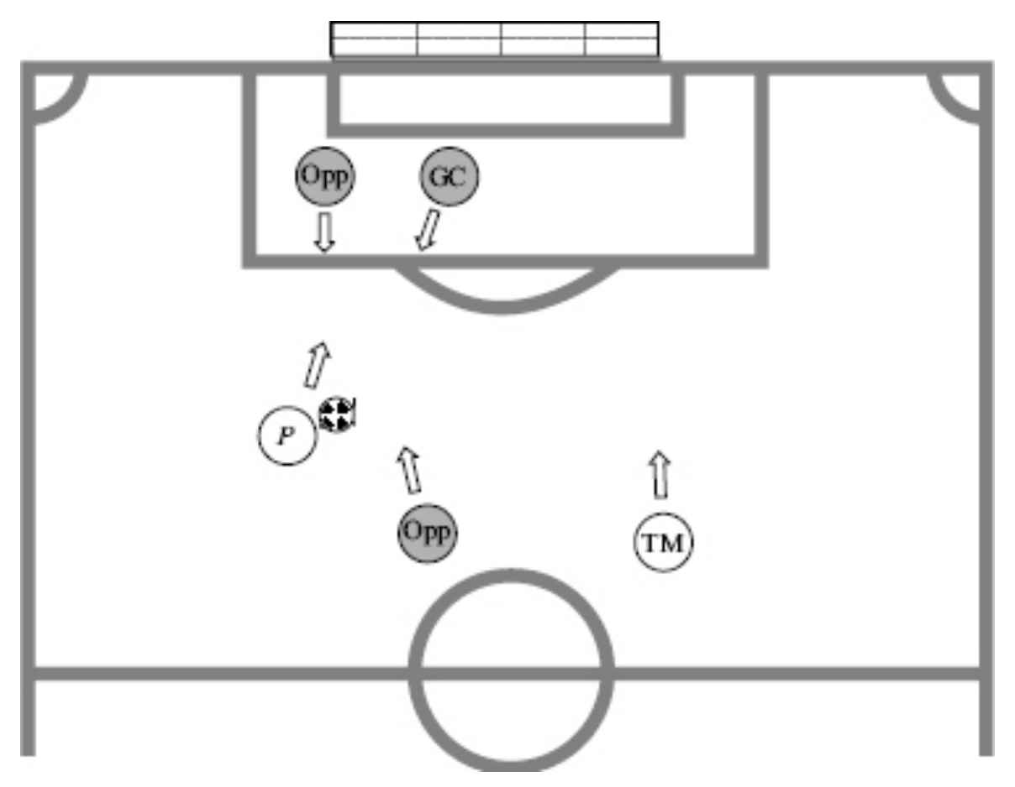
Football playing

Slide 4
Use the term agent to refer to the problem solver
The problem solver, or the agent, operates on a representation of the space in which the problem has to be solved and also a representation of the moves or decisions that the agent has to choose from to solve the problem.
The algorithms will be general purpose in nature and could be adapted to solve problems in different domains
A user would only have to implement the domain description and call the domain specific functions from the general program.

Slide 6
We model the problem solving process as traversing a state space.
The state space is a space in which each element is a state.
A state is a description of the world in which the problem solver operates.
The given situation is described by a state called the START state.
The desired or the goal situation is described by one or more GOAL states.
In any given state, an action or a decision by the agent changes something and the agent makes a move to a new state.
The task is to make a sequence of moves, such that the agent ends up being in a goal state.

Slide 7
The set of choices available to us implicitly define the space in which the decision making process operates.
Initially, we are in some given state, or the START state. We desire to be in some state that we will call the GOAL state, as shown in next figure.
The desired state may be described completely, identifying the state, or it could be described partially by some desirable properties; in which case there may be more than one goal state satisfying the properties.
The given state being the current state is described completely.

Slide 8
This transformation from the start state to the goal state is to be made by a sequence of moves that are available to us in the domain of problem solving.
In the beginning, the search algorithm (or agent) can only "see" the start state.
It has access to some move generation operators that determine which states are reachable in one step.
The algorithm has to choose one of these moves.
Each move applied to a given state transforms it into another state.
Task is to find those sequences of moves that will transform our current (START) state into the desired (GOAL) state.

Slide 9
State space

Slide 10
The solution

Slide 11
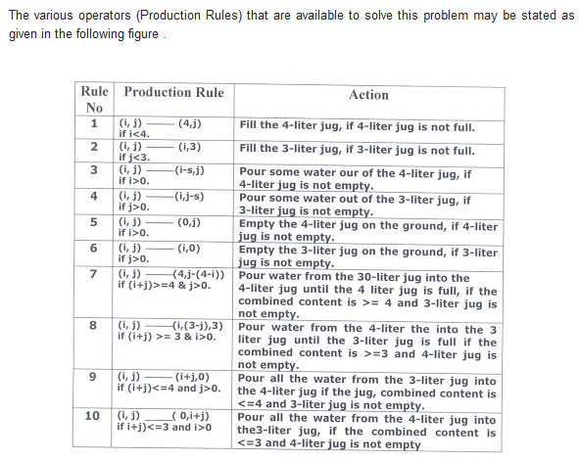

Slide 12
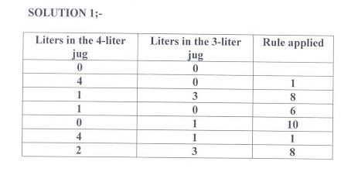

Slide 13
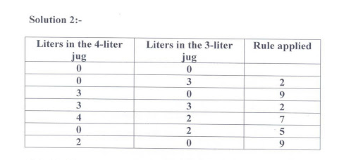

Slide 14
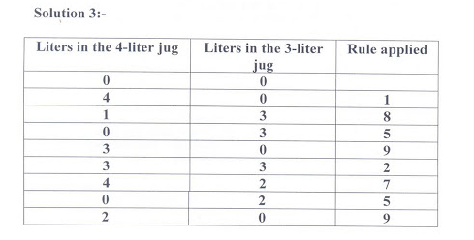

Slide 15
Generate and test
Basic approach is to search the state space looking for the solution.
The high level search algorithm has two components; one, to generate a candidate from the state space, and two, to test whether the candidate generated is the solution.
Generate And Test( )
While more candidates exist
Do Generate a candidate
Test whether it is a solution
return FAILURE
Assume that the problem domain has functions defined that allow us to operate in the domain.

Slide 16
At the moment, two functions required to be defined on the domain. They are the following:
moveGen(State) Takes a state as input and returns a set of states that are reachable in one step from the input state, as shown in Figure 2.6.
We call the set of states as successors or children of the input state. The input state is the parent of the children.
goalTest(State) Returns true if the input state is the goal state and false otherwise. (This is used when the goal is described by some properties that are checked by the function )
goalTest(State, Goal) Returns true if State matches Goal, and false otherwise. (This takes an explicit goal state and uses that to compare with the candidate state.)

Slide 17
Figure 2.6 The moveGen function returns a set of states that are reachable in one from a given state

Slide 18
Observe that we may have either of the above goal-test functions.
The former is used when the goal is described by some properties that are checked by the function.
The latter takes an explicit goal state and uses that to compare with the candidate state.
Search algorithms should be able to operate in any domain for which the above functions are provided.
We view the set of states as `nodes' in the state space, and the set of moves as the edges connecting these nodes.
Thus our view of the state space will be that of a graph that is defined implicitly by the domain function moveGen.

Slide 19
The next figure depicts the part of the state space generated and explored by the Generate&Test algorithm.
The generated space is known as the search tree generated by the search program.
Many real world problems can indeed be posed as search problems, we prefer simpler problems often posed as puzzles.
Small, well defined problems are easy to visualize and easy to implement, and serve to illustrate the algorithms.
Real problems on the other hand would be complex to represent, and divert from the understanding of search methods.
Common sorts of puzzles are river-crossing puzzles.

Slide 20
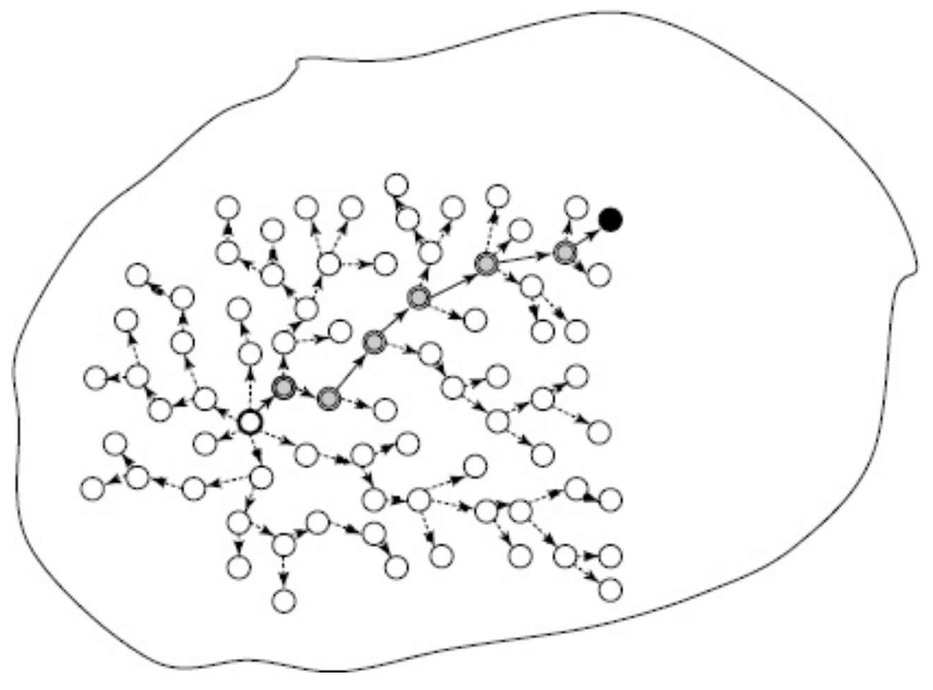

Slide 21
In these puzzles, a group of entities need to cross the river, but all of them cannot cross at the same time due to the limited capacity of the boat or the bridge.
In addition, there may be constraints that restrict the combination of entities that can stay in one place.
The next figure shows the well known Eight Puzzle used extensively in one of the earliest textbooks on artificial intelligence (Nilsson, 1971).
The goal is to find a path to a desired arrangement of tiles, for example as shown in Figure 2.8.
The idea in weak methods or general methods in artificial intelligence (Al) is that we develop a general algorithm that can be applied to many domains.

Slide 22
Question: In the missionaries and cannibals problem, three missionaries and three cannibals must cross a river using a boat which can carry at most two people, under the constraint that, for both banks, if there are missionaries present on the bank, they cannot be outnumbered by cannibals (if they were, the cannibals would eat the missionaries). The boat cannot cross the river by itself with no people on board.

Slide 23
